Slide 1
Literatúra

Slide 2
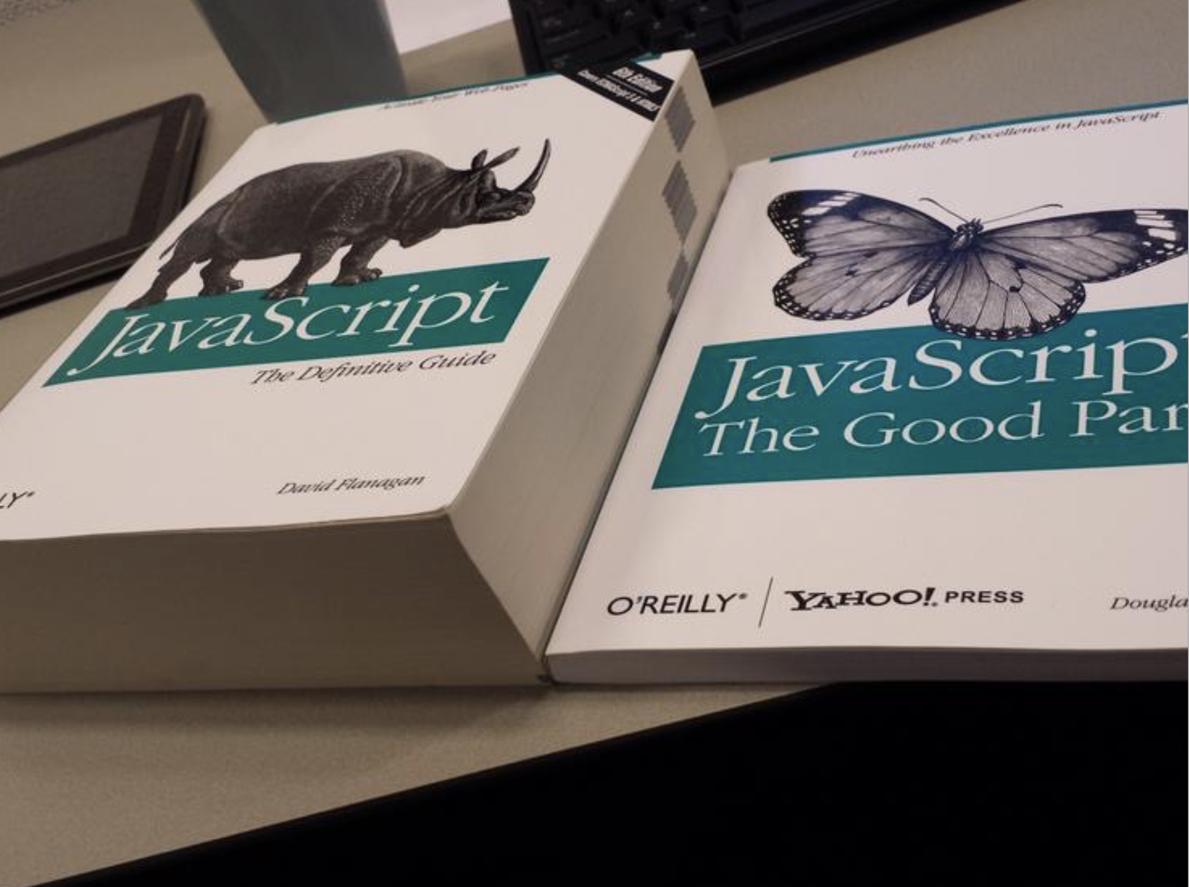
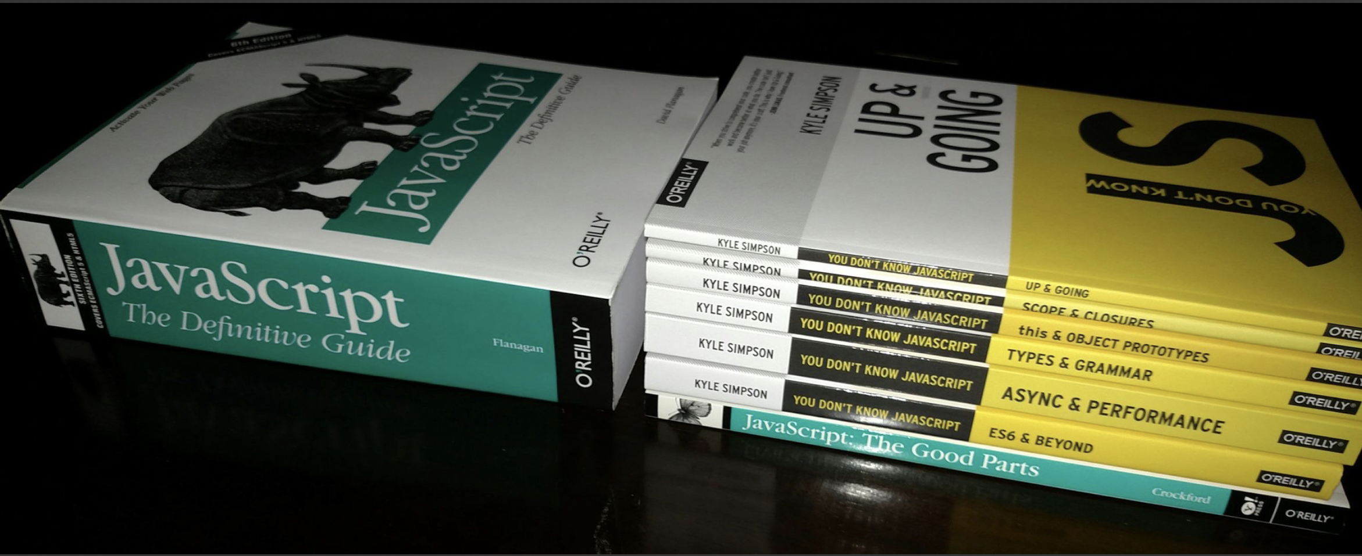
While this subset has been famously dubbed "The Good Parts", I would implore you, dear reader, to instead consider it the "The Easy Parts", "The Safe Parts", or even "The Incomplete Parts". [@getify]

Slide 3
Node.js Design Patterns - Second Edition
What You Will Learn
Design and implement a series of server-side JavaScript patterns so you understand why and when to apply them in different use case scenarios
Become comfortable with writing asynchronous code by leveraging constructs such as callbacks, promises, generators and the async-await syntax
Identify the most important concerns and apply unique tricks to achieve higher scalability and modularity in your Node.js application
Untangle your modules by organizing and connecting them coherently
Reuse well-known techniques to solve common design and coding issues
Explore the latest trends in Universal JavaScript, learn how to write code that runs on both Node.js and the browser and leverage React and its ecosystem to implement universal applications
by Mario Casciaro, Luciano Mammino
Paperback,
526 Pages, Published 2016

Slide 4
Secrets of the JavaScript Ninja, 2nd Edition
What You Will Learn
Writing more effective code with functions, objects, and closures
Learning to avoid JavaScript application pitfalls
Using regular expressions to write succinct text-processing code
Managing asynchronous code with promises
Fully revised to cover concepts from ES6 and ES7
by John Resig, Bear Bibeault, Josip Maras
375 Pages, Published 2016

Slide 5
Beginning Functional JavaScript: Functional Programming with JavaScript Using EcmaScript 6
What You Will Learn
Master functional programming concepts
Identify how functions are treated in JavaScript
Understand real-world functional libraries and create a functional library that mimics underscore.js
Perform pure-error handling techniques such as functors and monads
Discover ES6 functional features such as spread operators and generators
by Anto Aravinth
164 Pages, Published 2017

Slide 6
Reactive Programming with Node.js 1st Edition
What You'll Learn:
Review the variations of Reactive programming
Use the main libraries that provide this type of development experience in Node.js
Create a custom library
Scale up a system developed using RP in Node.js
by Fernando Doglio
153 Pages, Published 2016

Slide 7
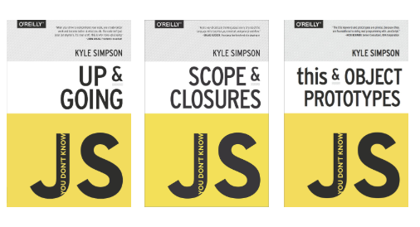
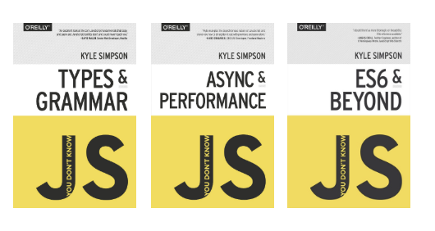
You Don't Know Js (6 Book Series)
What You'll Learn:
Scope & Closures
this & Object Prototypes
Up & Going
Async & Performance
ES6 & Beyond
Types & Grammar
by Kyle Simpson
https://github.com/getify/You-Dont-Know-JS

Slide 8
http://exploringjs.com/
http://2ality.com/

Slide 9
Coding/Quiz Resources
https://www.codewars.com
https://www.codingame.com/
https://tech.io
...

